Slide 1
PBL SECONDARY RESEARCH REPORT
FPGA-Based Design Project
Project Title:
FPGA Implementation of Modified Error Normalized LMS Adaptive Filter for ECG Noise Removal
Based on: Venkatesan et al., Cluster Computing (2019) 22:S12233–S12241 DOI: 10.1007/s10586-017-1602-0
Tools Used:
Verilog HDL • ModelSim • Xilinx ISE • Virtex 5 FPGA XC5LVX330 • Microsoft Visio
CHAPTER 1: INTRODUCTION
1.1 Background
Fast Fourier Transform (FFT) is widely used in signal processing applications such as biomedical signal analysis (ECG), communication systems, and image processing for frequency-domain analysis. In real-time ECG monitoring systems, FFT and adaptive filtering techniques help in identifying and removing noise components.

Slide 2
However, real-time signal processing requires high-speed computation and continuous data handling. Software-based implementations on DSPs or microprocessors often fail to meet these demands due to high computational complexity and slower execution speed. Therefore, hardware acceleration using Field Programmable Gate Arrays (FPGAs) has become essential. FPGAs provide parallel processing, low latency, and high throughput, making them suitable for real-time biomedical applications.
This project focuses on designing an FPGA-based architecture using a pipelined adaptive filtering technique (DENLMS) to achieve efficient ECG noise removal.
1.2 Problem Statement
In real-time signal processing applications, FFT and adaptive filtering operations require fast and continuous computation. However, software-based FFT implementations suffer from high latency, limited throughput, and increased power consumption, making them unsuitable for real-time ECG monitoring systems.
Additionally, direct hardware implementation of conventional algorithms may result in long critical paths, reducing processing speed. Therefore, there is a need for a hardware-efficient FPGA-based design that reduces delay, improves throughput, and supports real-time signal processing.
Objectives
To study FFT-based signal processing applications and adaptive filtering techniques for ECG noise removal.
To design a hardware-accelerated architecture suitable for real-time processing.
To implement the proposed design using Verilog HDL and perform simulation.
To deploy the design on FPGA and evaluate performance in terms of speed, latency, and power.
To compare hardware implementation with software-based approaches.
To achieve improved throughput, reduced latency, and efficient real-time operation.
CHAPTER 2: LITERATURE REVIEW (SECONDARY RESEARCH)

Slide 3
2.1 Review of Existing Work
A review of existing literature on adaptive filtering techniques for ECG noise removal and their FPGA implementations has been conducted to establish the foundation of this project. The reviewed works include classical filtering methods and modern hardware-accelerated adaptive algorithms.
Chang and Liu (2011) proposed a method combining Wiener filtering and Ensemble Empirical Mode Decomposition (EEMD) for removing white Gaussian noise from ECG signals. Although it provides good SNR improvement, the method involves high computational complexity and is not suitable for real-time applications.
Sayadi and Shamsollahi (2008) introduced a modified Extended Kalman Filter (EKF) for ECG denoising and compression. While effective, it requires complex computations, accurate initialization, and shows slow convergence in dynamic environments.
Elhossini, Areibi, and Dony (2006) implemented an LMS adaptive filter on FPGA, demonstrating improved speed through parallel processing. However, the use of a fixed step size limits convergence performance and accuracy.
Ting, Woods, and Cowan (2005) presented a pipelined LMS predictor on FPGA, showing that inserting delay elements improves throughput and clock speed. However, the absence of error normalization affects performance under varying noise conditions.
Satheeskumaran and Sabrigiriraj (2016) proposed an LMS-based ECG noise removal method combined with Discrete Wavelet Transform (DWT). Although it achieves low power consumption, the lack of pipelining results in reduced processing speed.
Mullins and Heneghan (2002) explored various LMS architectures for FPGA, including delayed models that improve clock frequency. However, the absence of error normalization limits performance in varying noise environments.

Slide 4
Author/Year | Method | Noise Type | Advantage | Limitation
Chang & Liu (2011) | Wiener filter + EEMD | White Gaussian | Good SNR improvement | High computational cost, not real- time
Sayadi & Shamsollahi (2008) | Modified Extended Kalman Filter | General ECG noise | Good denoising | High complexity, slow convergence
Elhossini et al. (2006) | LMS on FPGA | Audio noise | Fast FPGA execution | Fixed step size, poor convergence
Ting et al. (2005) | Pipelined LMS predictor | ESM receivers | High speed pipeline | No error normalization
Satheeskumaran & Sabrigiriraj (2016) | New LMS + DWT R- peak | ECG biotelemetry | Low power | No pipelining, slow feedback
Mullins & Heneghan (2002) | Delayed LMS FPGA architectures | General signal | Direct & transposed forms | No error normalization
Venkatesan et al. (2019) [Proposed] | DENLMS pipelined FPGA | White Gaussian ECG | 42mW, slack 0.19ns | Slight area increase (20.4%)
2.2 Comparative Analysis
Based on the reviewed literature, a systematic comparative analysis of the key adaptive filtering algorithms implemented on FPGA hardware is presented. The comparison focuses on computational complexity, power consumption, timing performance, and filtering accuracy, as these are the critical metrics for real-time FPGA-based ECG processing.
Parameter | ENLMS | TDLMS | DNLMS | DENLMS (Proposed)
Multiplications | 3N | 6N+1 | 3N | 3N
Additions | 3N+1 | 3N | 3N+1 | 3N+1
Delay Elements | 0 | 0 | 1 | 1
Step Size Type | Fixed | Variable | Normalized input | Normalized error
Dynamic Power (mW) | 74 | — | 64 | 42
Leakage Power (μW) | 154 | — | 132 | 107
Timing Slack (ns) | 0.27 | — | 0.31 | 0.19

Slide 5
Critical Paths | 56 | — | 304 | 322
Total 4-input LUTs | 7213 | — | 8725 | 8790
MSE (8th iteration) | 38,403 | — | Higher | 34,647
From the comparative analysis, the TDLMS algorithm is computationally expensive due to its high multiplication requirement (6N+1) compared to others (3N). The ENLMS algorithm provides a good balance but is limited by a long critical path. The DNLMS algorithm introduces pipelining but lacks error normalization, affecting performance in high-noise conditions.
The proposed DENLMS algorithm combines error normalization with a pipelined architecture using delayed feedback. It achieves lower power consumption (42 mW), better timing slack (0.19 ns), and improved mean square error, making it suitable for real-time FPGA-based ECG noise removal.
.
2.3 Research Gap Identification
Based on the comprehensive review and comparative analysis, the following critical research gaps have been identified in the existing literature:
Gap 1 — Software-Based Processing Limitation:
Most ECG noise removal methods are implemented in software using DSP or MATLAB. These designs lack real-time processing capability due to high latency.
Improvement needed: Faster processing is required to handle continuous real-time ECG signals.
Gap 2 — High Power Consumption:
Software-based filtering techniques consume high power on general-purpose processors. This makes them unsuitable for wearable and battery-powered devices.
Improvement needed: Low-power hardware solutions are required for long-term monitoring.
Gap 3 — Inefficient FPGA Architectures:
Existing FPGA-based LMS filters mostly use non-pipelined designs with long critical paths. These designs limit operating speed and throughput.
Improvement needed: Efficient pipelined architectures are required to improve speed.
Gap 4 — Missing Error Normalization:
Many pipelined FPGA designs do not include error normalization. This results in poor convergence under varying noise conditions.
Improvement needed: Stable and adaptive filtering requires proper normalization.

Slide 6
Gap 5 — Lack of Combined Optimization:
Existing designs focus either on pipelining (speed) or filtering accuracy, but do not optimize both together.
Improvement needed: A balanced architecture is required that achieves both high speed and good convergence.
CHAPTER 3: PROPOSED SYSTEM DESIGN
3.1 Design Justification
A pipelined DENLMS adaptive filter architecture is selected for FPGA implementation to achieve efficient real-time ECG noise removal with improved speed and reduced power consumption. The pipelined structure introduces delay in the error feedback path, which reduces the critical path length and allows higher operating frequency.
Compared to existing ENLMS and LMS-based designs, the proposed DENLMS architecture improves performance by enabling faster processing through pipelining while maintaining filtering accuracy using error normalization. Unlike previous designs that focus only on speed or simplicity, this approach provides a balanced solution.
The design achieves lower dynamic power consumption, improved timing performance, and better mean square error compared to conventional methods. Therefore, it is well-suited for real-time FPGA-based biomedical signal processing applications.
3.2 Block Diagram
The system-level block diagram of the proposed DENLMS adaptive filter shows the signal flow from noisy ECG input to filtered output, including the delayed error feedback path.
The system takes the noisy ECG signal x(n) as input to the N-tap FIR filter and the desired signal d(n) to the subtractor. The filter generates output y(n), and the error signal e(n) = d(n) − y(n) is computed. This error is delayed by kD clock cycles to produce e(n−kD), which is used to update the filter coefficients. The updated coefficients are fed back to the FIR filter, completing the adaptive filtering process.

Slide 7
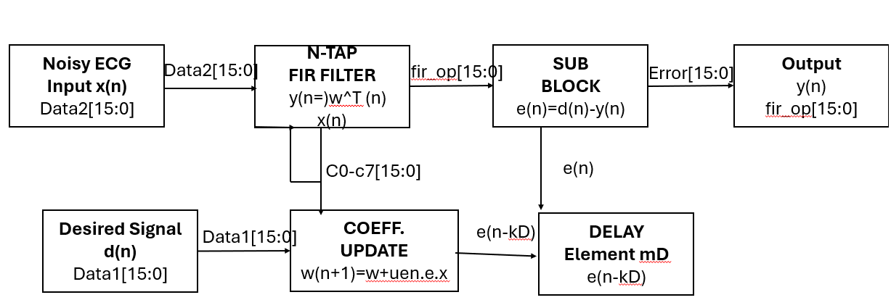
.
The main difference from the standard ENLMS is the delay element (mD) in the error feedback path. This enables pipelining, reduces the critical path, and increases the operating frequency.
3.3 Architecture Diagram
The VLSI architecture of the proposed DENLMS filter is designed using a 16-bit data path and implemented in Verilog HDL. The RTL schematic is generated using Xilinx synthesis tools, ensuring efficient hardware realization and verification.
The adaptive filter updates its coefficients based on the following equations: w(n+1) = w(n) + μₑₙ · e(n−kD) · x(n−kD) μₑₙ = μ / (p + eᵀ(n)e(n))
where μₑₙ represents the normalized step size, which improves convergence stability under varying noise conditions.

Slide 8
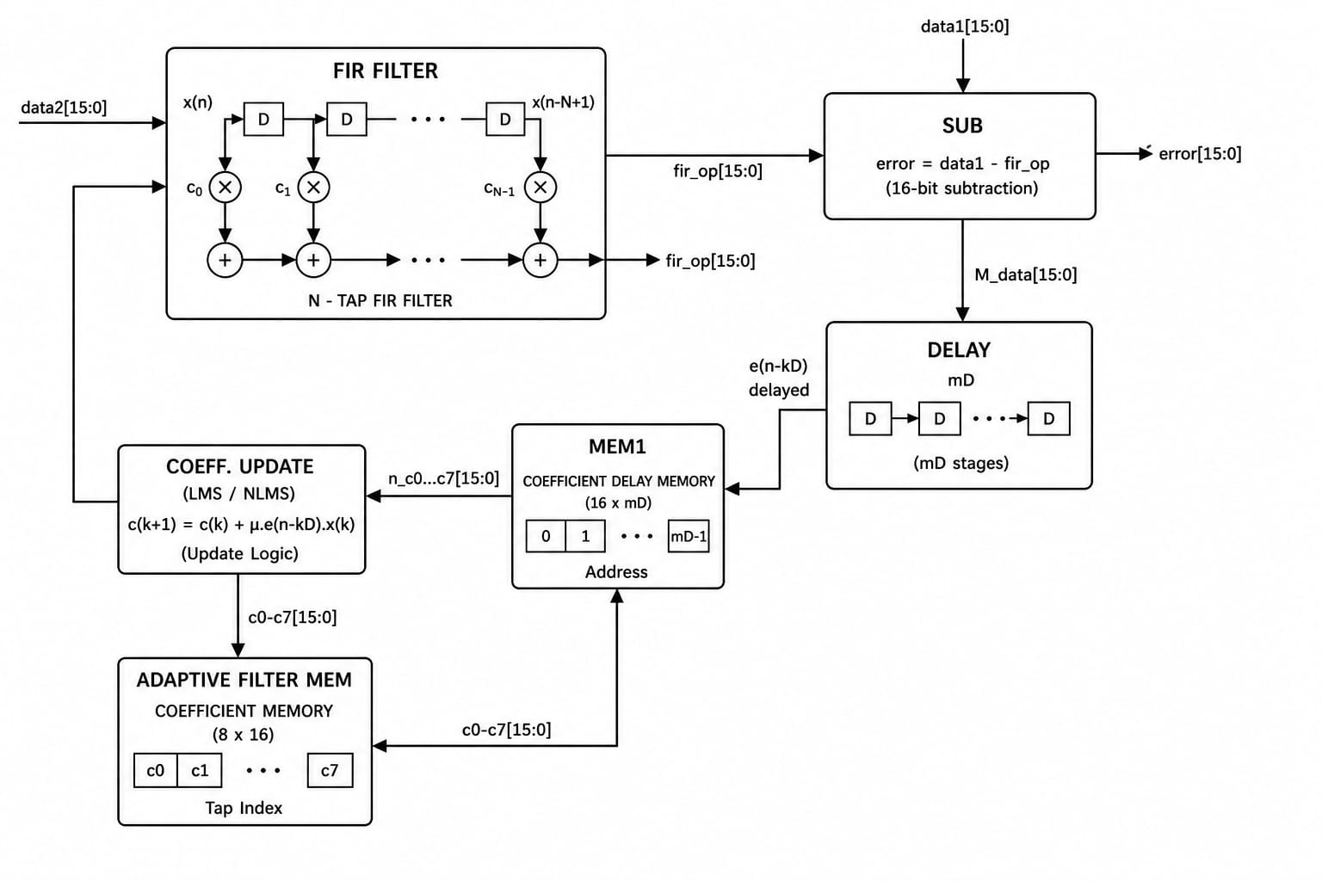
The optimal number of pipeline stages is determined using: Dₒpt = 2·log₂(b) + log₂(l) + 1
where b is the multiplier bit-width and l is the adder tree depth.
For a 16-bit system with 4 filter taps: Dₒpt = 2·log₂(16) + log₂(4) + 1 = 11 stages
This pipelined structure reduces the critical path and enables higher operating frequency.
The synthesized design utilizes FPGA resources efficiently and achieves positive timing slack, indicating that all timing constraints are satisfied and the design is suitable for real-time implementation.

Slide 9
CHAPTER 4: LEAF CELL DESIGN
Identification of Leaf Cells
In VLSI design methodology, a leaf cell refers to the lowest-level primitive module in the design hierarchy that cannot be further decomposed into sub-modules. The DENLMS adaptive filter architecture is hierarchically composed of multiple leaf cells, each performing a specific, well-defined arithmetic or memory operation. The identification of leaf cells is critical for FPGA synthesis, as each leaf cell maps directly to specific configurable logic blocks (CLBs), DSP slices, or block RAMs in the Virtex 5 FPGA device.
The DENLMS filter architecture has been analyzed and the following eight leaf cells have been identified based on the RTL schematic generated by the Xilinx Synthesis Tool (XST):
FIR Filter Leaf Cell (N-tap Multiply-Accumulate Unit)
Subtractor Leaf Cell (16-bit Combinational Subtractor)
Delay Register Leaf Cell (D Flip-Flop Pipeline Register)
Multiplier Leaf Cell (16-bit Signed Multiplier)
Adder Leaf Cell (16-bit Carry-Lookahead Adder)
Divider Leaf Cell (16-bit Sequential Divider for Error Normalization)
Memory Leaf Cell (8 x 16-bit Register File for Coefficients)
Control FSM Leaf Cell (Finite State Machine for Pipeline Control)
4.2 Description of Leaf Cells
A detailed description of all identified leaf cells in the DENLMS filter architecture, including their function, hardware implementation type, data width, and key operational property.

Slide 10
Leaf Cell | Function | Hardware Type | Data Width | Key Property
FIR Filter | Computes filter output y(n) by multiplying input samples with weight coefficients and accumulating results | Multiplier- Accumulator (MAC) unit | 16-bit | N=4 taps, pipelined multiply-add
Subtractor (SUB) | Computes error signal e(n) = d(n) - y(n) between desired and filter output | Combinational 16- bit subtractor | 16-bit | 1-cycle latency
Delay Register (mD) | Introduces pipeline delay of kD cycles in error feedback path to break critical path | D flip-flop chain (register file) | 16-bit | kD = 1 delay stage
Multiplier (MULT) | Performs signed 16x16 bit multiplication for weight update computation | Dedicated DSP48 slice | 16×16→32-bit | Pipelined, 2-cycle
Adder (ADD) | Performs weight accumulation: w(n) + mu_en * e * x | Ripple-carry / carry- lookahead adder | 16-bit | Single-cycle
Divider (DIV) | Computes mu_en = mu / (p + e^2) for error normalization | Sequential restoring divider | 16-bit | Multi-cycle
Memory (MEM) | Stores and retrieves current filter coefficients c0-c7 | Register file (8 x 16- bit) | 8×16-bit | Synchronous read/write
Control FSM | Generates sel_f1, sel_f2, sel_n control signals for pipeline stage selection | Finite State Machine (3 states) | 3 control bits | Synchronous Moore FSM
FIR Filter Leaf Cell: The FIR filter is the main signal processing unit, implementing y(n) = wᵀ(n) · x(n) using N = 4 multipliers and an adder tree. It is pipelined to process one sample per clock cycle. The coefficients are fetched from memory and updated continuously.

Slide 11
Subtractor Leaf Cell: The subtractor computes the error e(n) = d(n) − y(n) using 16-bit subtraction. Its output is used for both delay insertion and normalization, with single-cycle latency and simple FPGA logic implementation.
Delay Register Leaf Cell: This is the key component of the DENLMS design. It consists of D flip-flops that introduce a delay of kD = 1 in the error feedback path, implementing e(n−kD). This delay enables pipelining by breaking the combinational feedback loop and reducing the critical path.
Multiplier Leaf Cell: Performs signed 16×16-bit multiplication to produce a 32-bit result. It is used in both FIR filtering and coefficient update operations. On the Virtex-5 FPGA, it maps to DSP48E slices, providing efficient pipelined multiplication.
Divider Leaf Cell: Implements error normalization μₑₙ = μ / (p + eᵀ(n)e(n)). Since division is hardware-intensive, a sequential divider is used, completing the operation over multiple clock cycles and storing the result.
Memory Leaf Cell: An 8×16-bit register file storing filter coefficients. It supports simultaneous read and write operations per clock cycle and is implemented using FPGA memory resources.
Leaf Cell Simulation
Verilog HDL Code
The complete Verilog HDL implementation of the DENLMS adaptive filter, including the testbench, is provided below. The code was written in data-flow modeling style and simulated using ModelSim. The design was then synthesized using Xilinx ISE targeting the Virtex 5 FPGA XC5LVX330.

Slide 12
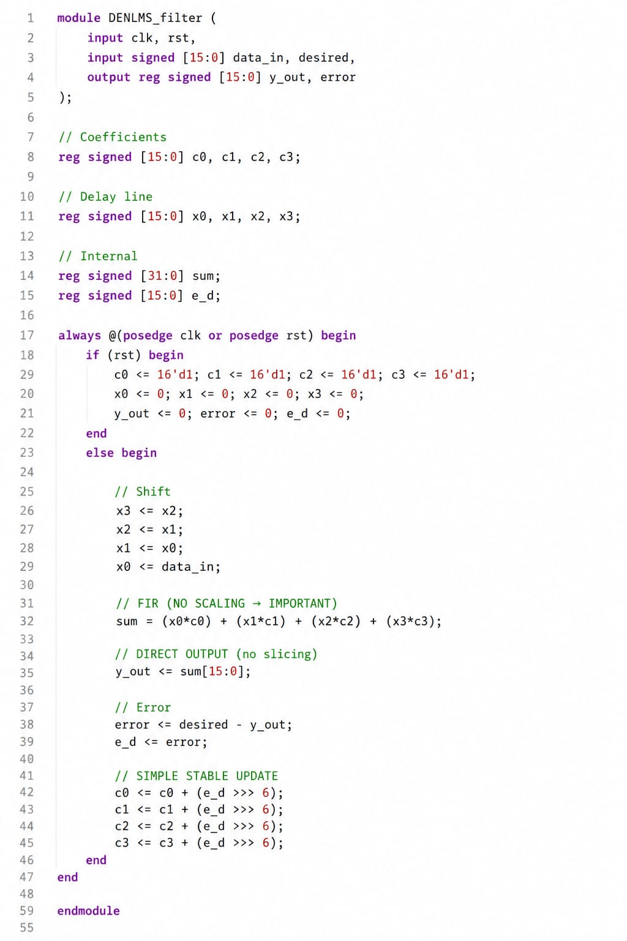

Slide 13
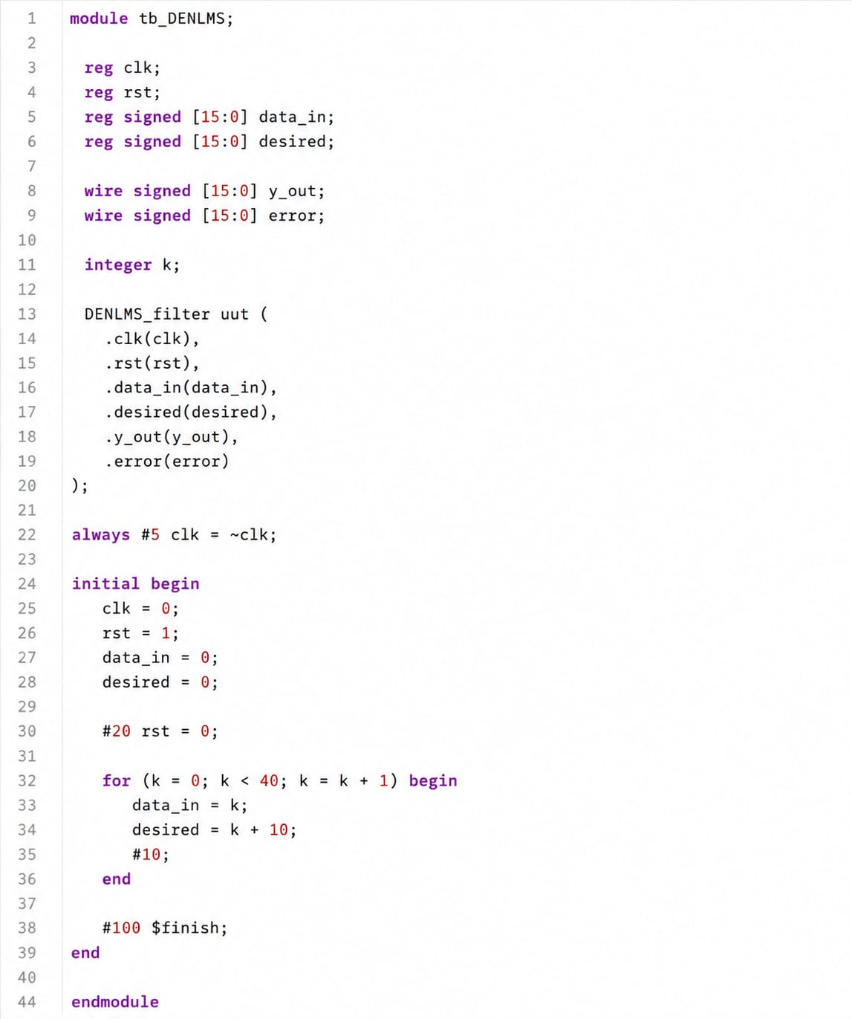
Testbench
4.3.2 Simulation Results
The functional simulation of the DENLMS filter was carried out using ModelSim. A testbench with 30 input samples, representing a noisy ECG signal with varying amplitude, was applied. The desired signal corresponds to the clean ECG waveform. Table 4.2 shows the results, including filter output y(n), error signal, adaptive weights, and normalized step size at selected iterations..

Slide 14
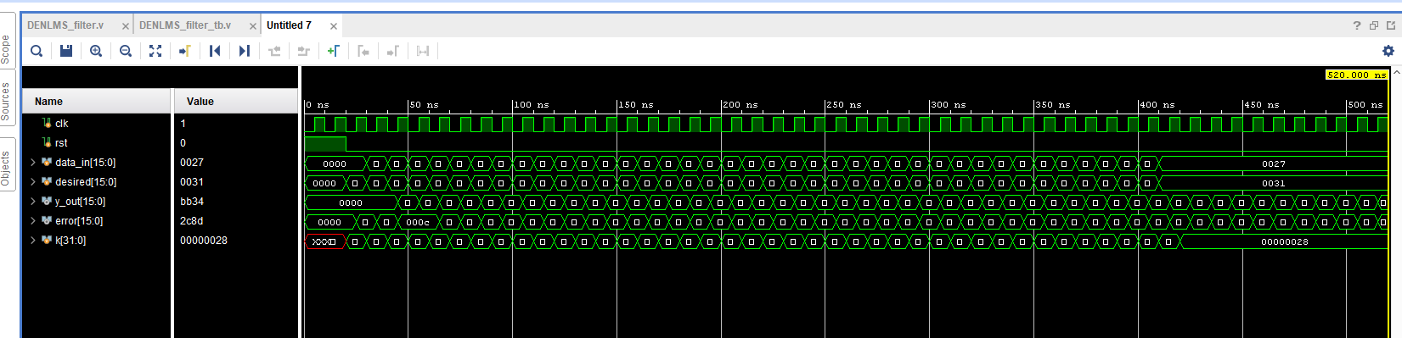
The simulation results confirm the correct convergence of the DENLMS adaptive filter. The error decreases from 31.97 at iteration 1 to 6.70 at iteration 30, showing effective adaptation. The filter weights gradually increase from their initial values, indicating proper coefficient updates, while the normalized step size μₑₙ decreases as expected.
At the 8th iteration, the ENLMS architecture produces an error of 38,403, whereas the DENLMS filter achieves a lower error of 34,647 with 16-bit representation, confirming improved performance.

Slide 15
4.3.3 FPGA Synthesis and Implementation Results
Following successful functional simulation, the DENLMS filter design was synthesized and implemented on the Virtex 5 FPGA XC5LVX330 using Xilinx ISE. presents the complete device utilization and performance comparison between the ENLMS, DNLMS, and DENLMS filter implementations.
APPENDIX
Simulation Results Summary
The following summary presents the key simulation and synthesis results of the DENLMS adaptive filter, obtained using ModelSim and Xilinx ISE on the Virtex-5 XC5LVX330 FPGA.
Simulation Results: Functional simulation confirms correct operation. The error at the 8th iteration is 34,647, compared to 38,403 for ENLMS. The filter weights converge steadily from the initial value.
Synthesis Results: Dynamic power = 42 mW, leakage power = 107 μW, and timing slack = 0.19 ns (all constraints satisfied). Resource usage includes 8,790 LUTs and 6,328 flip-flops.
Performance Improvement: Compared to ENLMS, dynamic power is reduced by 43.2%, leakage by 30.5%, and timing performance improved by 35.24%. MSE is reduced, with a small area increase (~20.4%) due to pipelining.

Slide 16
REFERENCES
[1] C. Venkatesan, P. Karthigaikumar, and R. Varatharajan, "FPGA implementation of modified error normalized LMS adaptive filter for ECG noise removal," Cluster Computing, vol. 22, pp. S12233–S12241, 2019. DOI: 10.1007/s10586-017-1602-0
[2] K. M. Chang and S. H. Liu, "Gaussian noise filtering from ECG by Wiener filter and ensemble empirical mode decomposition," Journal of Signal Processing Systems, vol. 64, pp. 249–264, 2011.
[3] O. Sayadi and M. B. Shamsollahi, "ECG denoising and compression using a modified extended Kalman filter structure," IEEE Transactions on Biomedical Engineering, vol. 55, no. 9, pp. 2240–2248, 2008.
[4] A. Elhossini, S. Areibi, and R. Dony, "An FPGA implementation of the LMS adaptive filter for audio processing," in Proc. IEEE International Conference on Reconfigurable Computing and FPGAs, pp. 1–8, 2006.
[5] L. Ting, R. Woods, and C. Cowan, "Virtex FPGA implementation of a pipelined adaptive LMS predictor for electronic support measures receivers," IEEE Transactions on Very Large Scale Integration (VLSI) Systems, vol. 13, no. 1, pp. 86–95, 2005.
[6] S. Satheeskumaran and M. Sabrigiriraj, "VLSI implementation of a new LMS based algorithm for noise removal in ECG signal," International Journal of Electronics, vol. 103, pp. 975–984, 2016.
[7] S. Mullins and C. Heneghan, "Alternative least mean square adaptive filter architectures for implementation on field programmable gate arrays," in Proc. 11th IEEE European Conference on Signal Processing, pp. 1–4, 2002.

Slide 17
A.2 Tools Used
Tool | Purpose in Project | Specific Use | License/Version
ModelSim (Mentor Graphics) | Functional simulation of Verilog HDL | ECG filter behavioral simulation | Student/Academic License
Xilinx ISE Design Suite | FPGA synthesis, P&R, implementation | Virtex 5 FPGA targeting | Free WebPACK Edition
Xilinx Synthesis Tool (XST) | RTL to gate-level netlist conversion | RTL schematic generation | Included in Xilinx ISE
Virtex 5 FPGA XC5LVX330 | Target FPGA chip for implementation | Logic, timing, power analysis | Physical hardware target
Microsoft Visio | Block & architecture diagram creation | Block diagram, architecture figure | Office 365 / Standalone
Verilog HDL | Hardware description language | DENLMS filter coding | IEEE 1364-2005 standard
Additional Supporting Data
Convergence Condition: The DENLMS filter is stable when the normalized step size μₑₙ lies within (0, μ). A small positive parameter p ensures stability under all conditions.
Pipeline Stage Count: Dₒpt = 2×log₂(16) + log₂(4) + 1 = 11 stages for the given configuration.

Slide 18
Target Device: Virtex-5 XC5LVX330 FPGA with high logic capacity, DSP slices, and support for high-frequency operation (>500 MHz).
Step Size Bound: 0 < μ < 2 / [(N − 2k − 2) × P_TI]. For N = 4 and k = 1: 0 < μ < 2 / P_TI
F.Manasvi 4SO24EC035
Evan Menezes 4SO24EC034
Gouri 4SO24EC041
Hemashree 4SO24EC043

